Slide 1
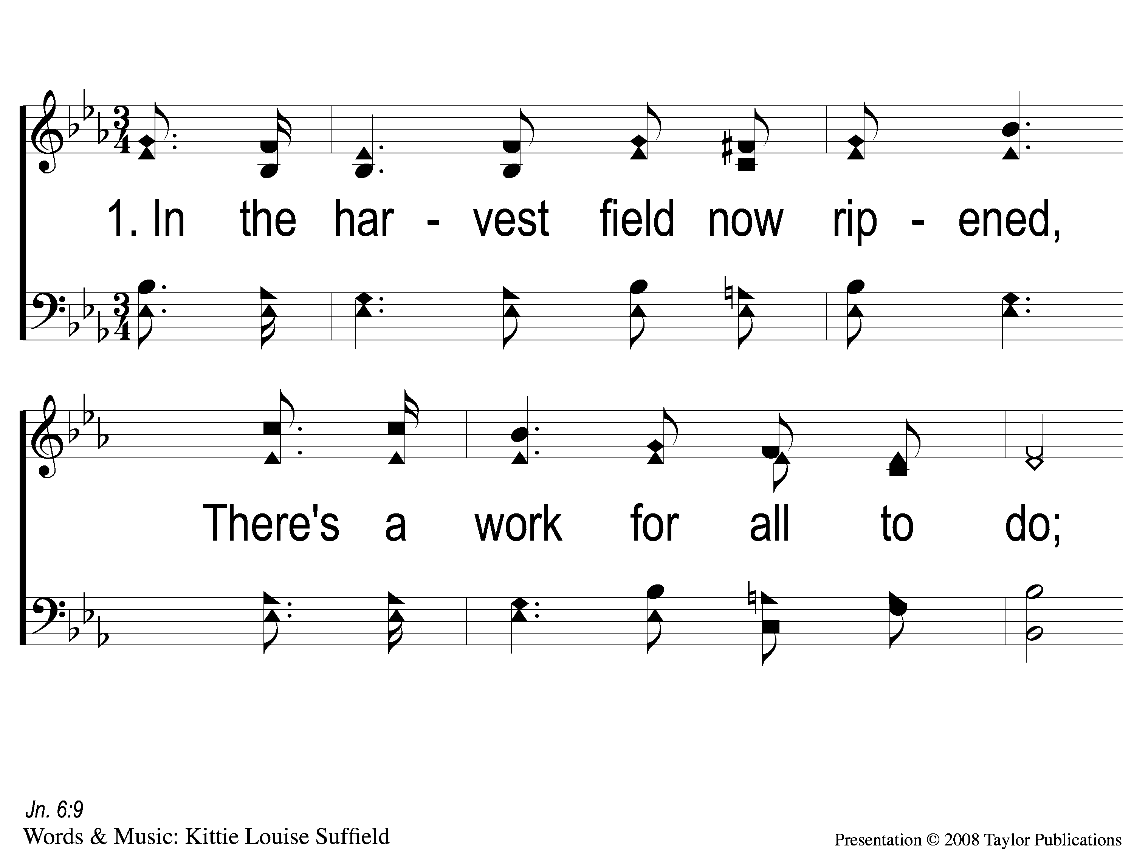
1-1 Little Is Much When God is In It
Little is Much When God is in It
86

Slide 2
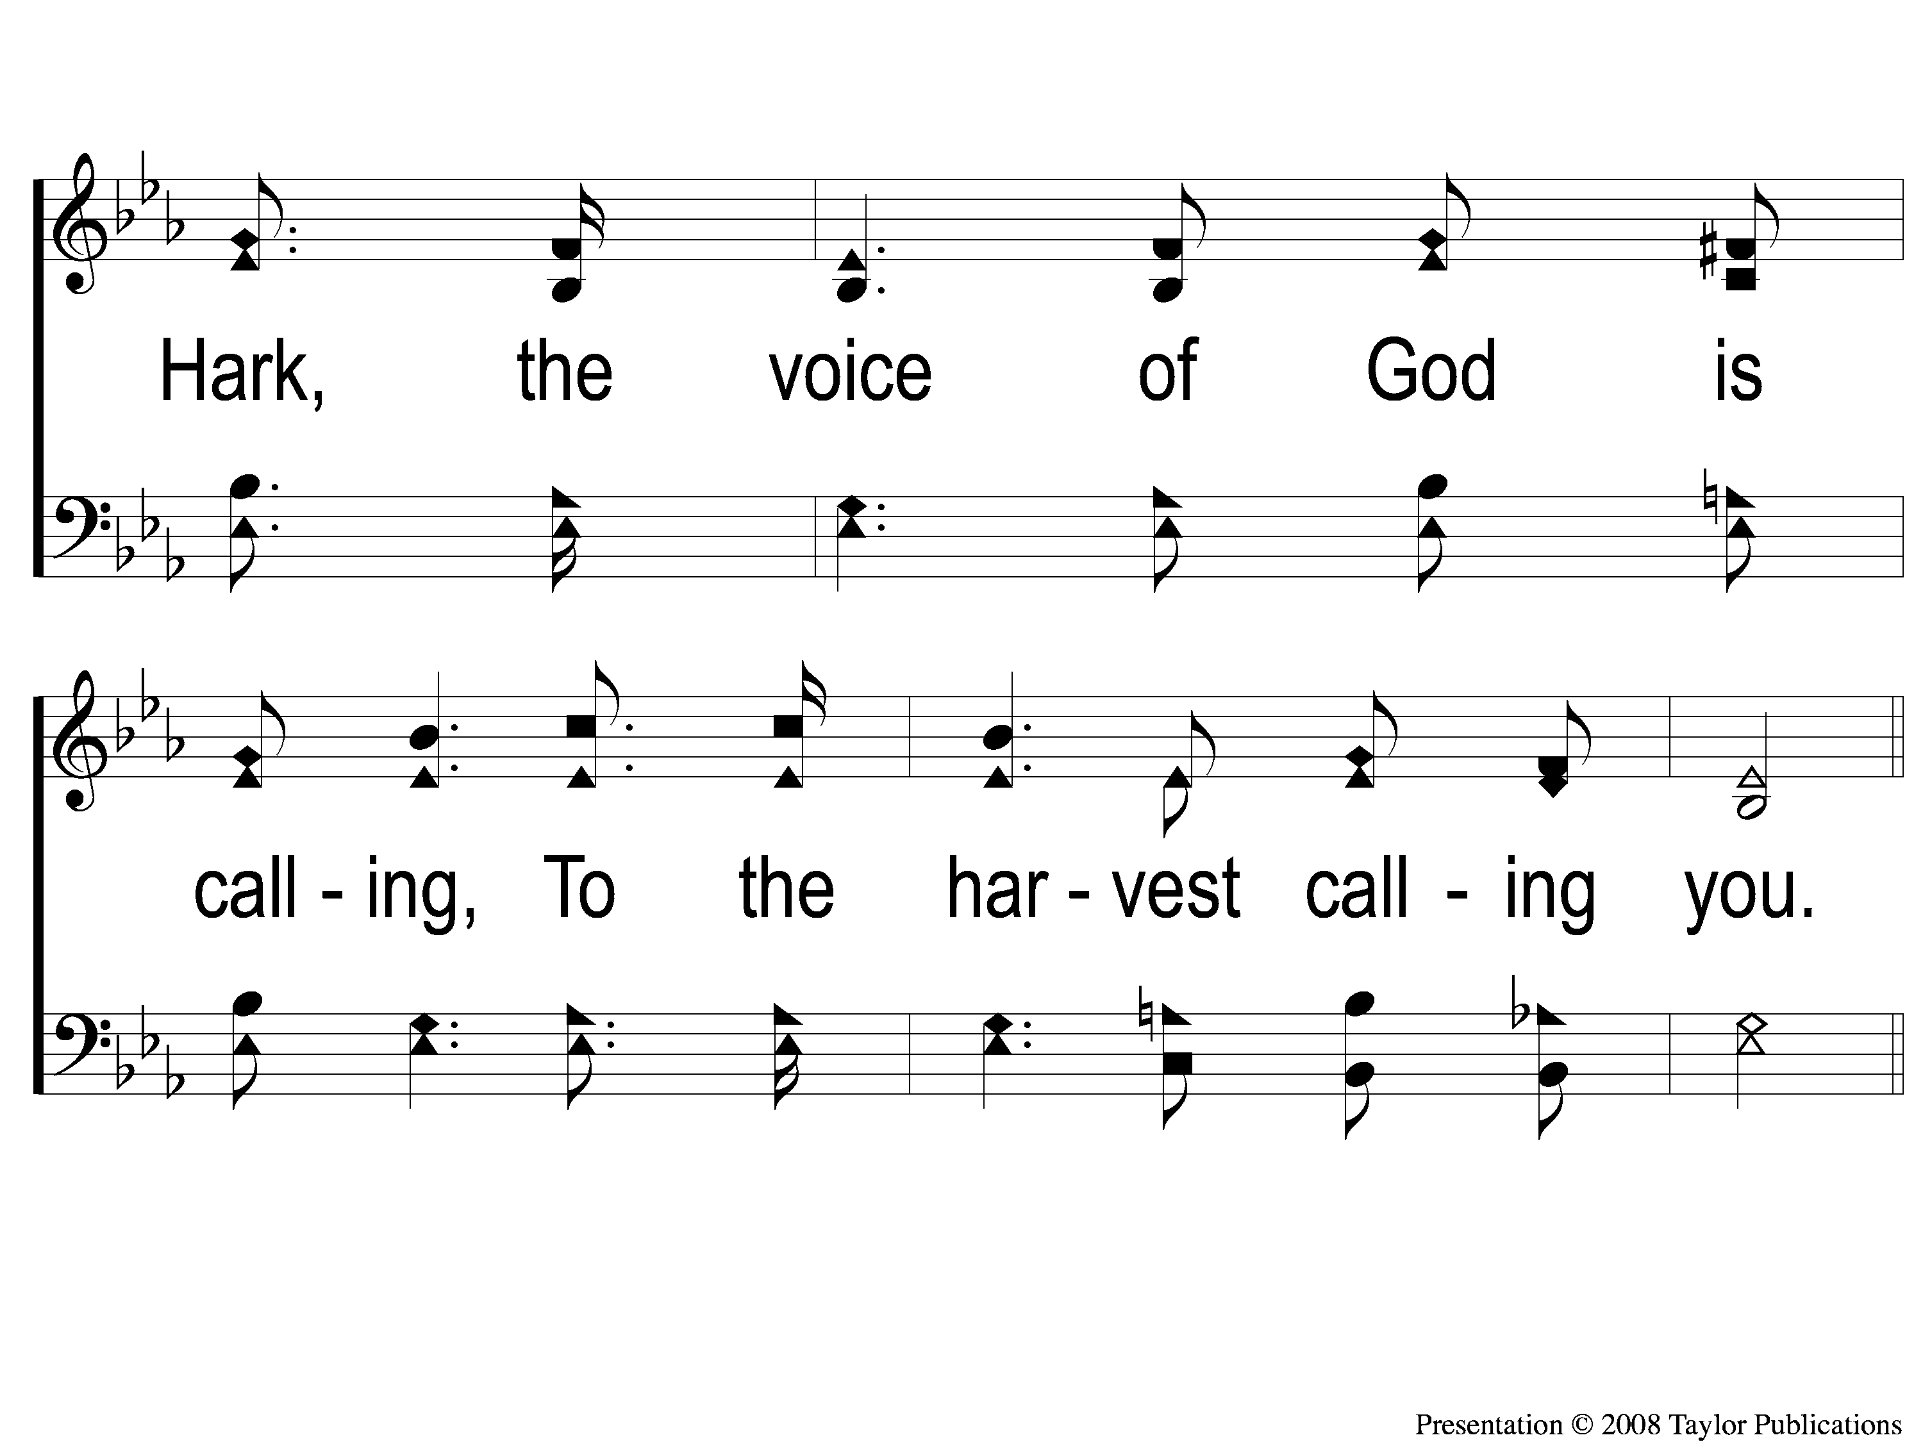
1-2 Little Is Much When God is In It
Little is Much When God is in It
86

Slide 3
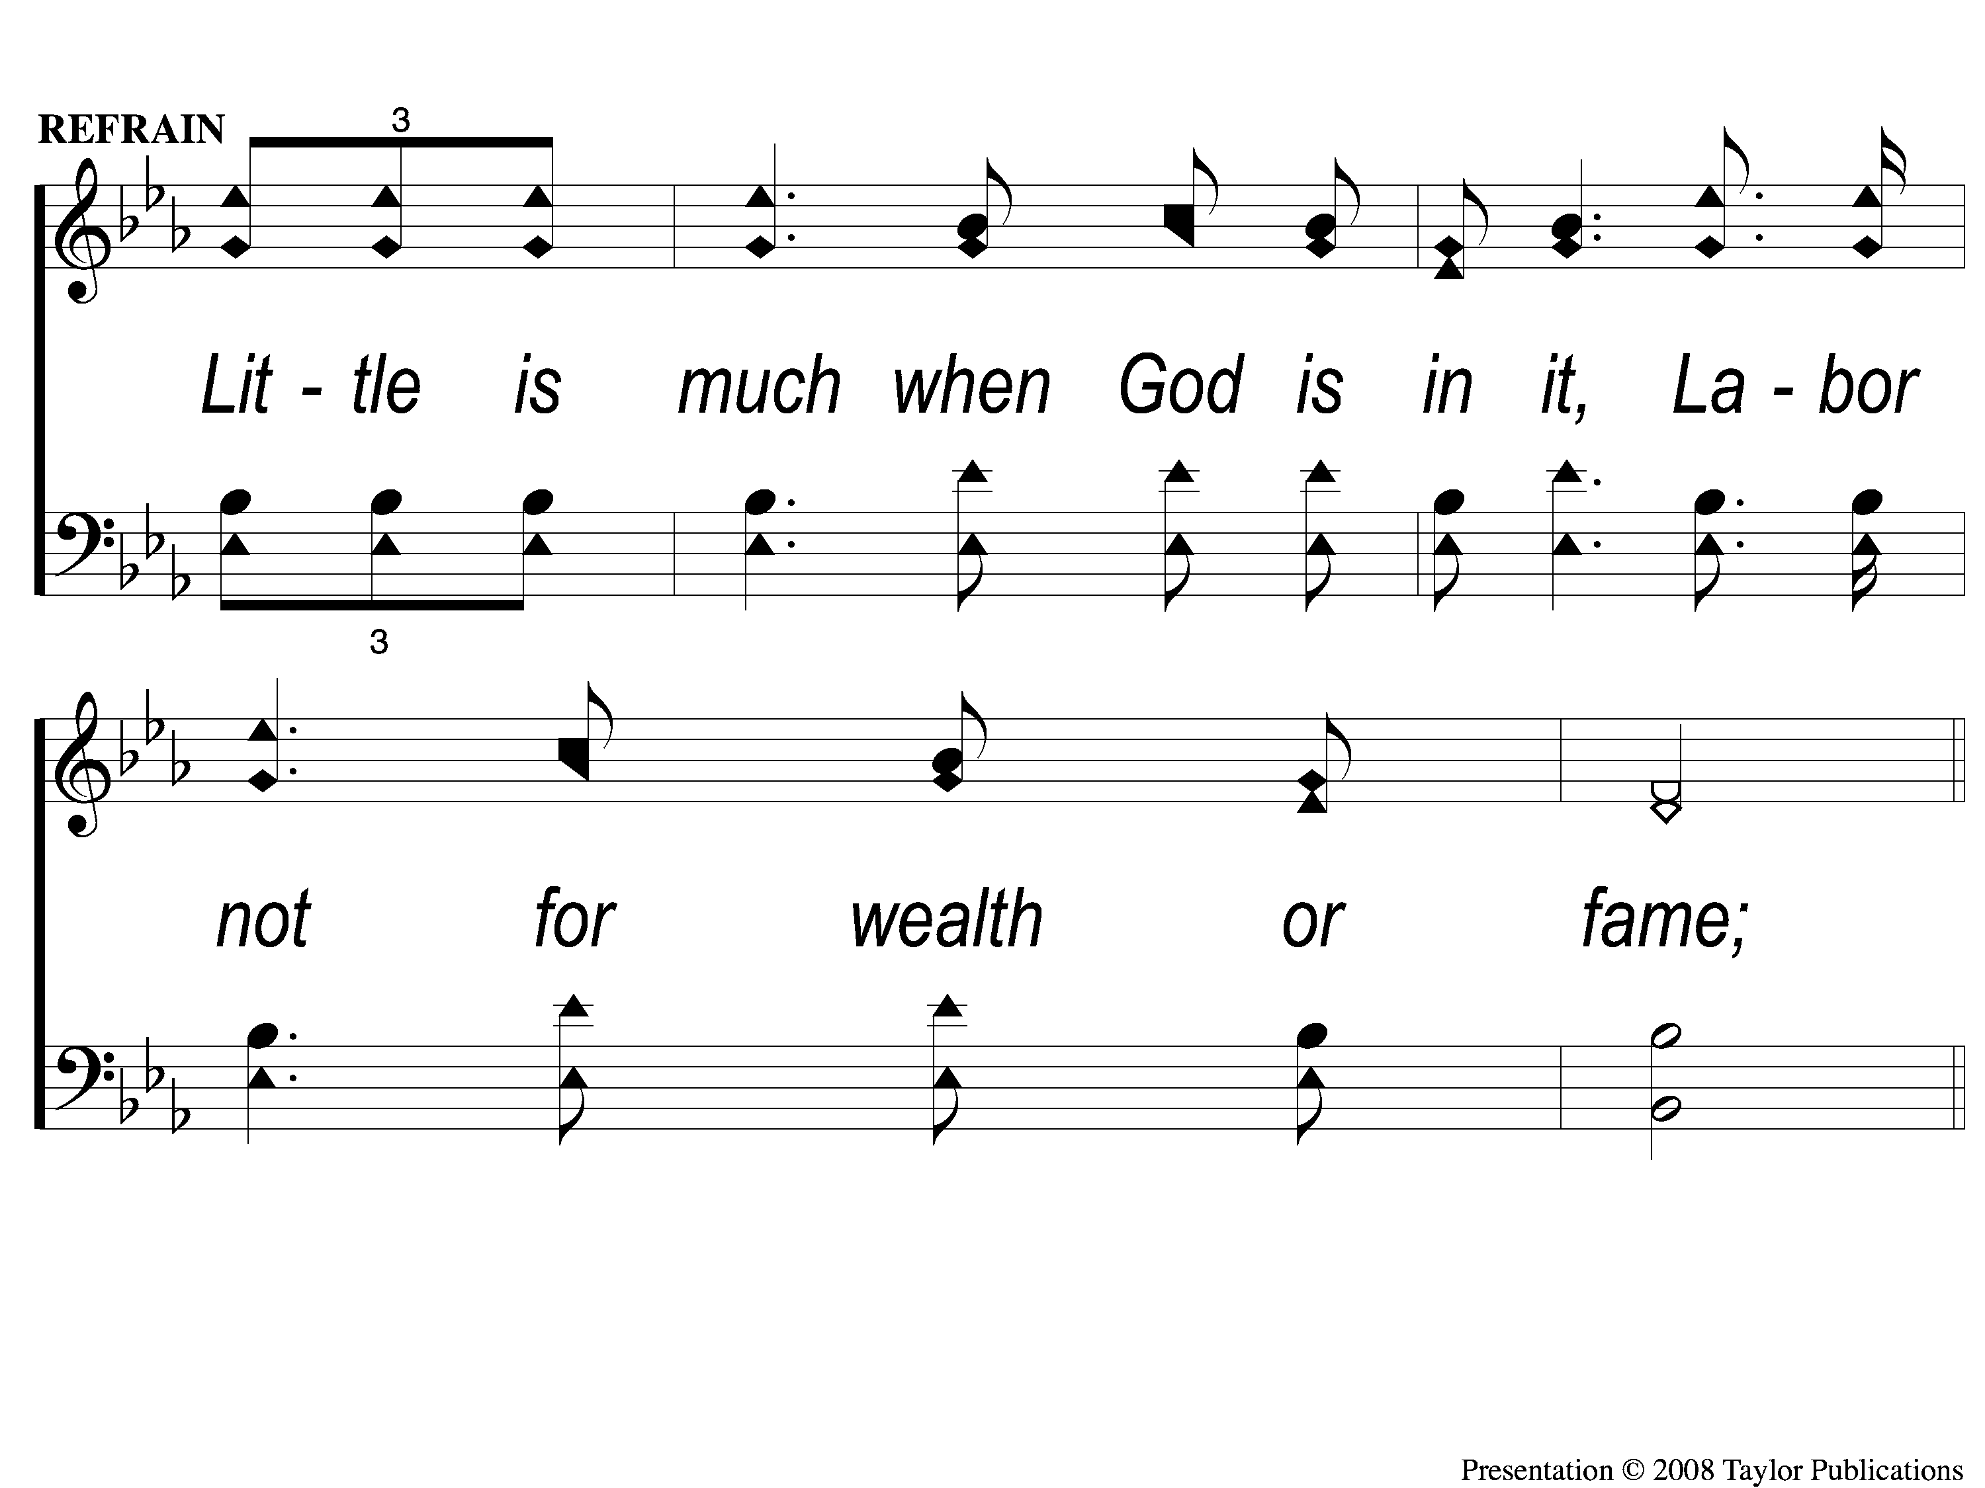
C-1 Little Is Much When God is In It
Little is Much When God is in It
86

Slide 4
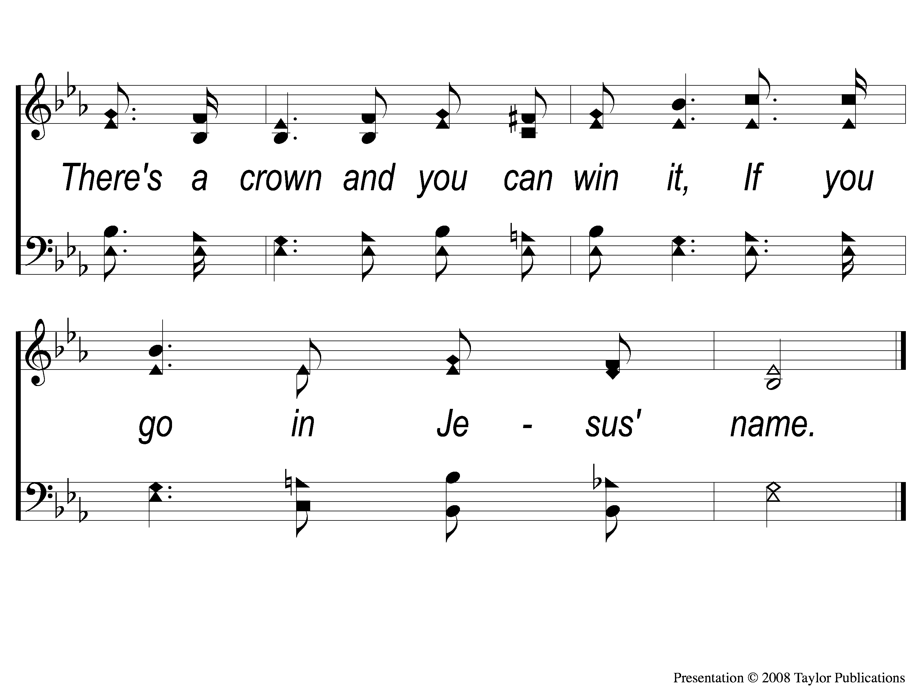
C-2 Little Is Much When God is In It
Little is Much When God is in It
86

Slide 5
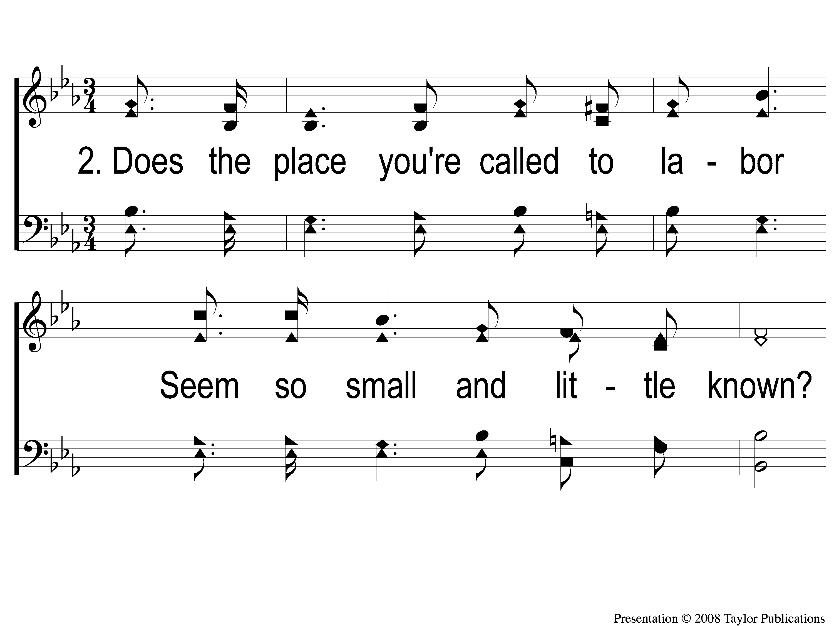
2-1 Little Is Much When God is In It
Little is Much When God is in It
86

Slide 6
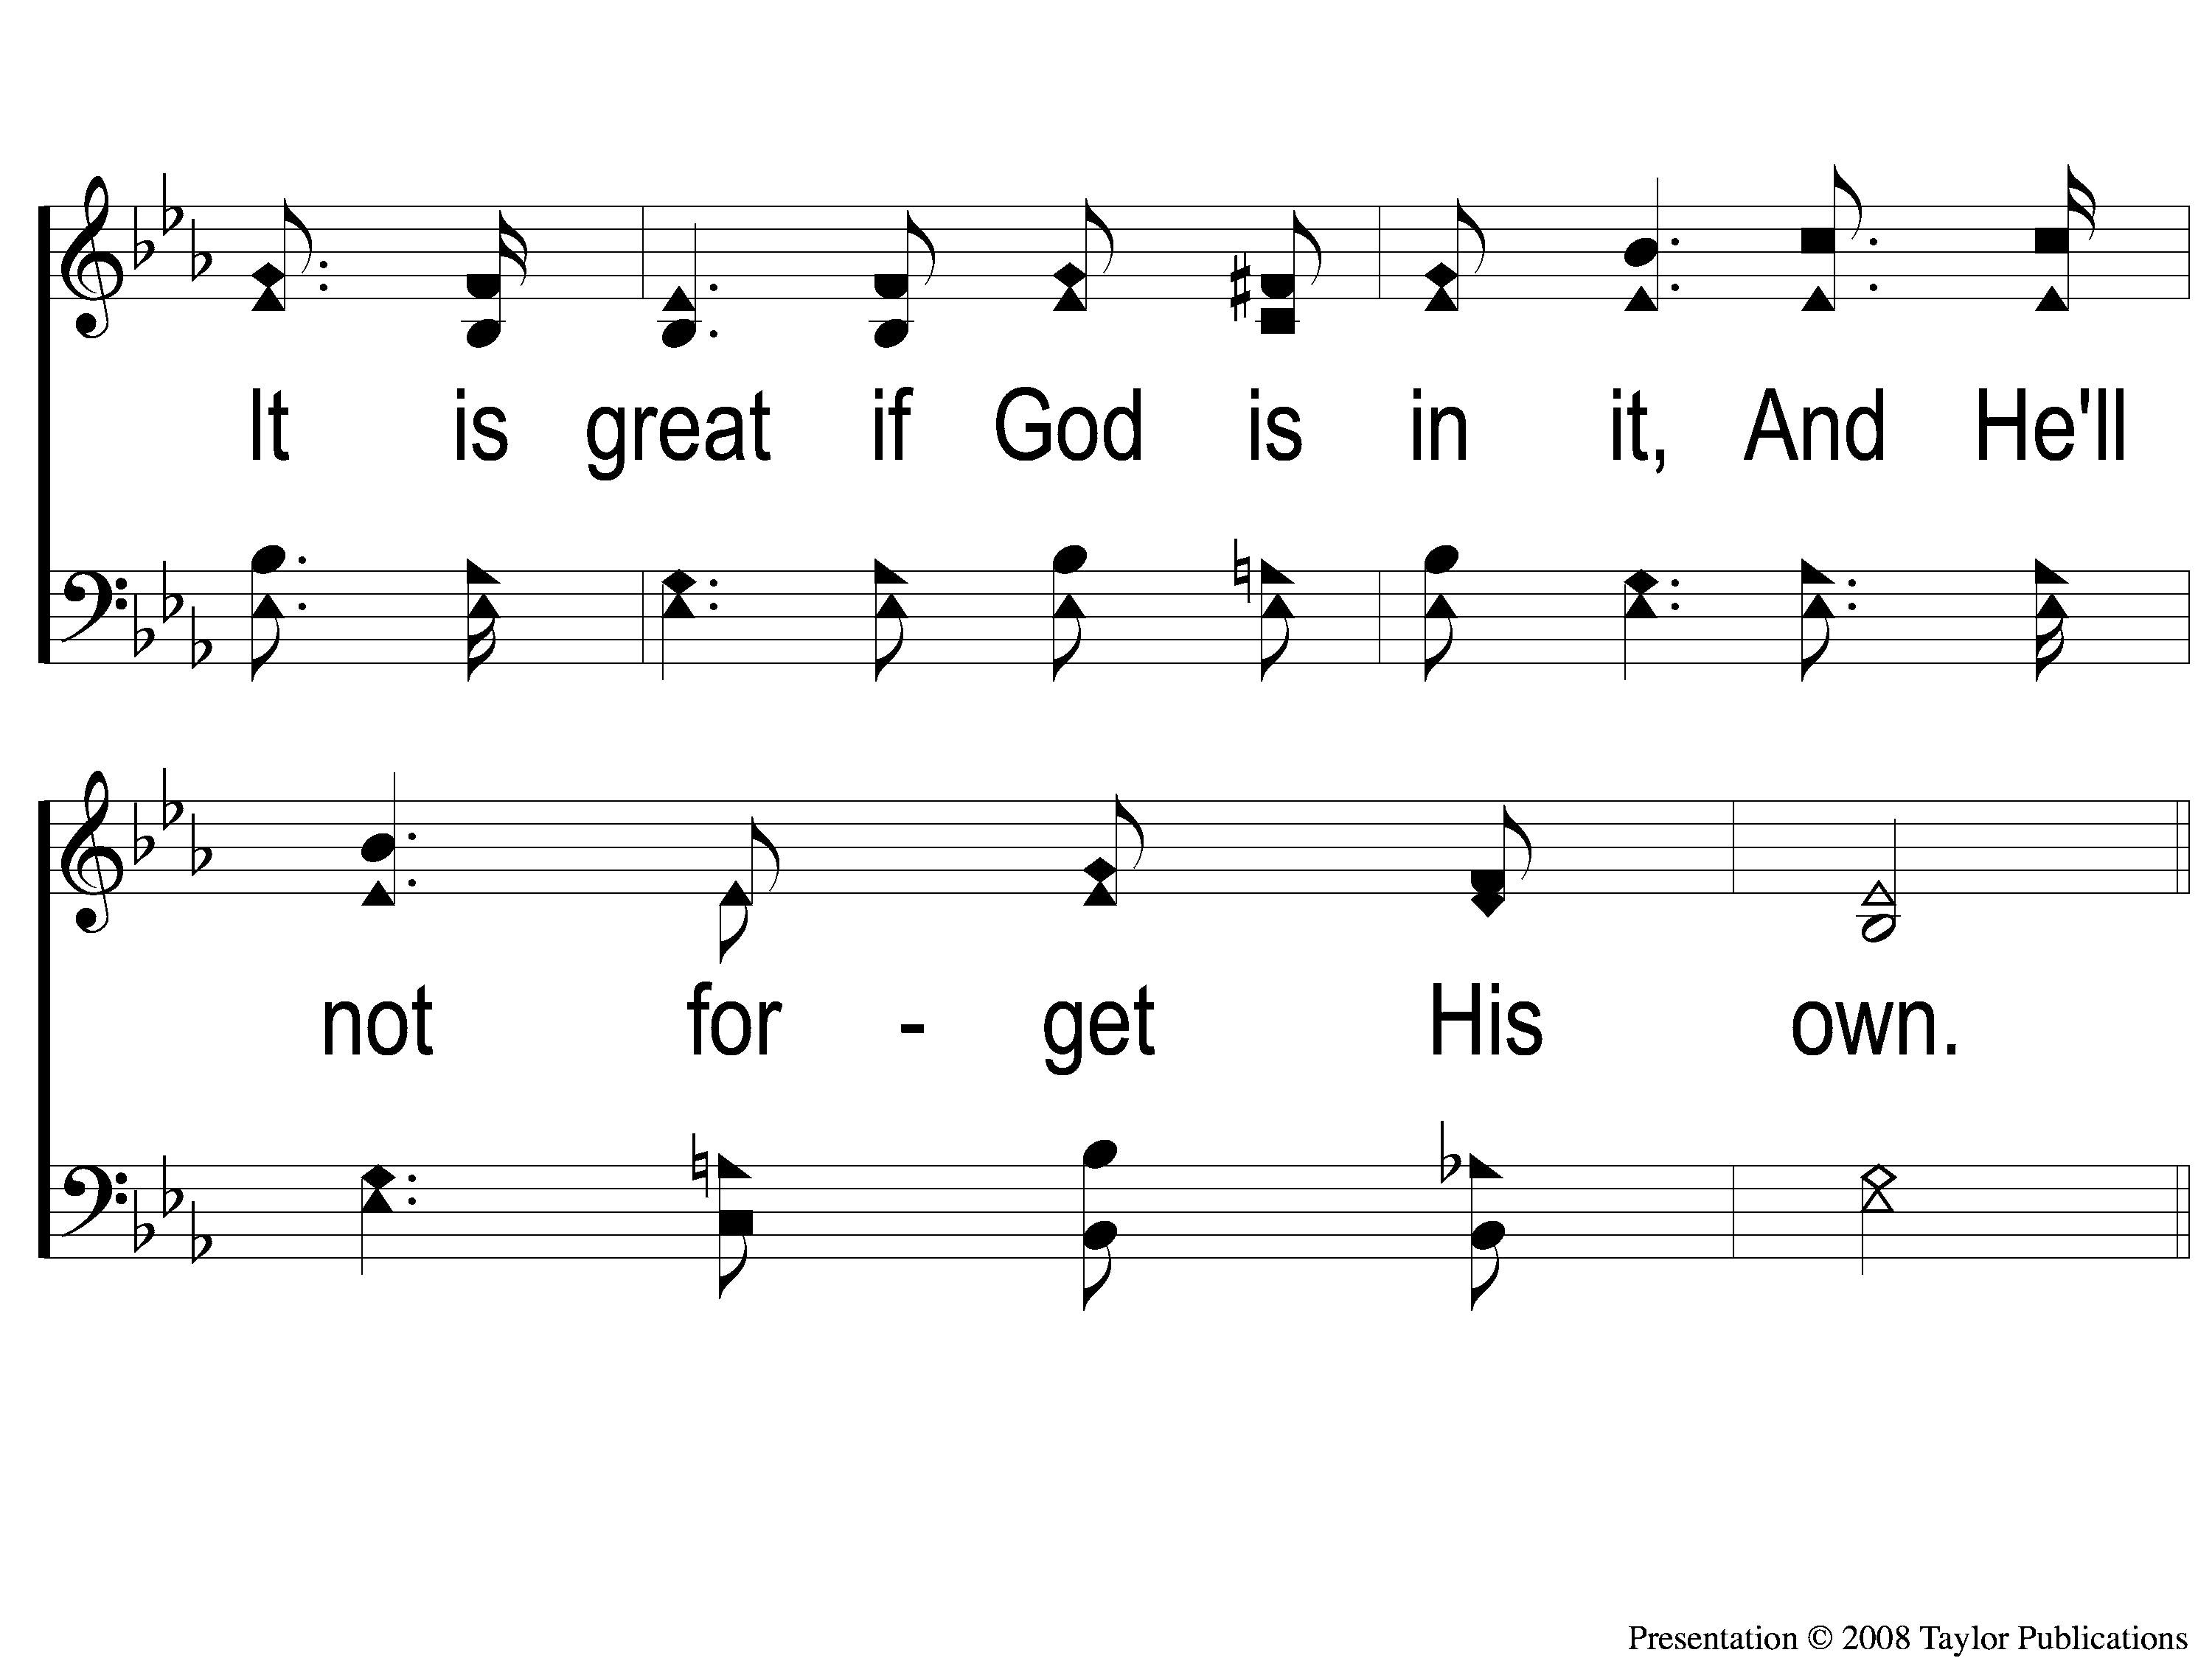
2-2 Little Is Much When God is In It
Little is Much When God is in It
86

Slide 7
C-1 Little Is Much When God is In It
Little is Much When God is in It
86

Slide 8
C-2 Little Is Much When God is In It
Little is Much When God is in It
86

Slide 9
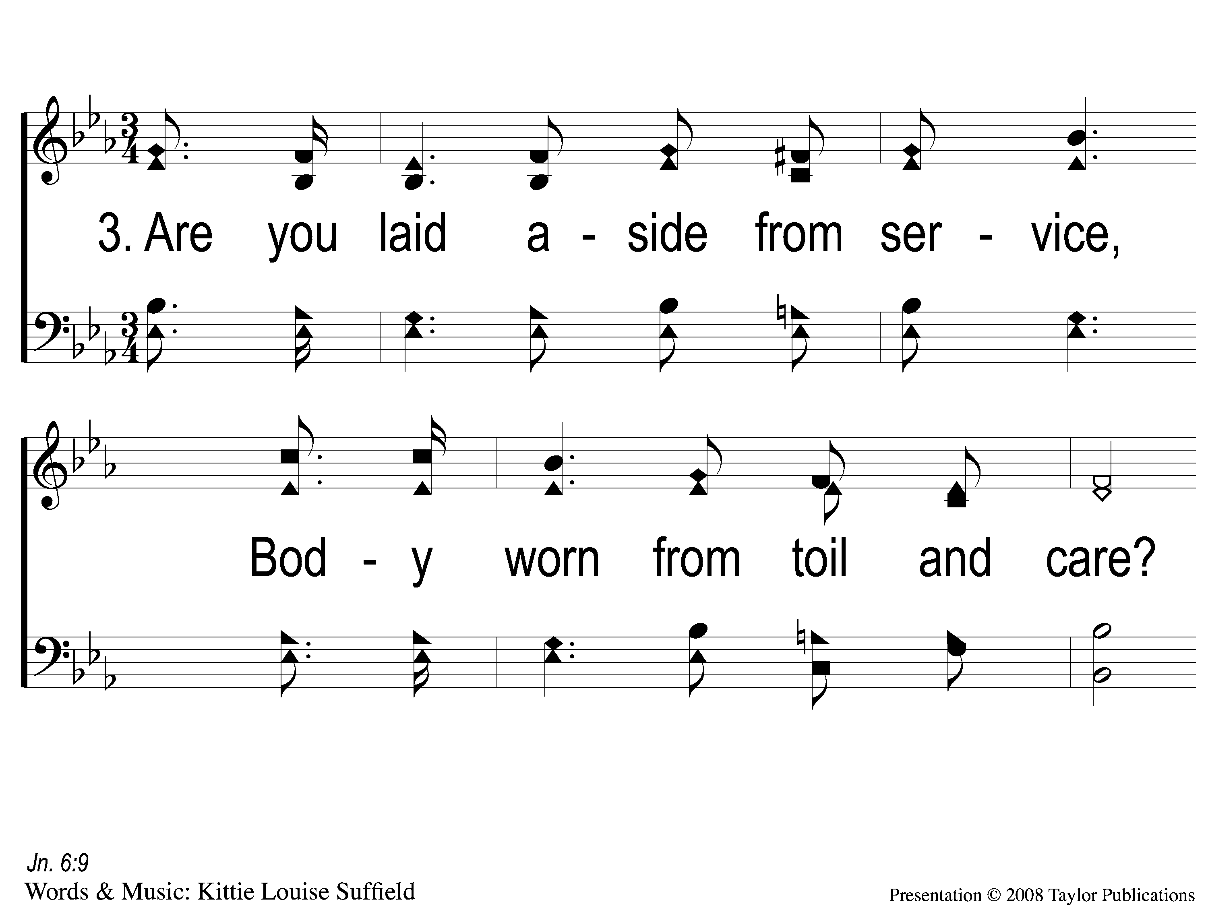
3-1 Little Is Much When God is In It
Little is Much When God is in It
86

Slide 10
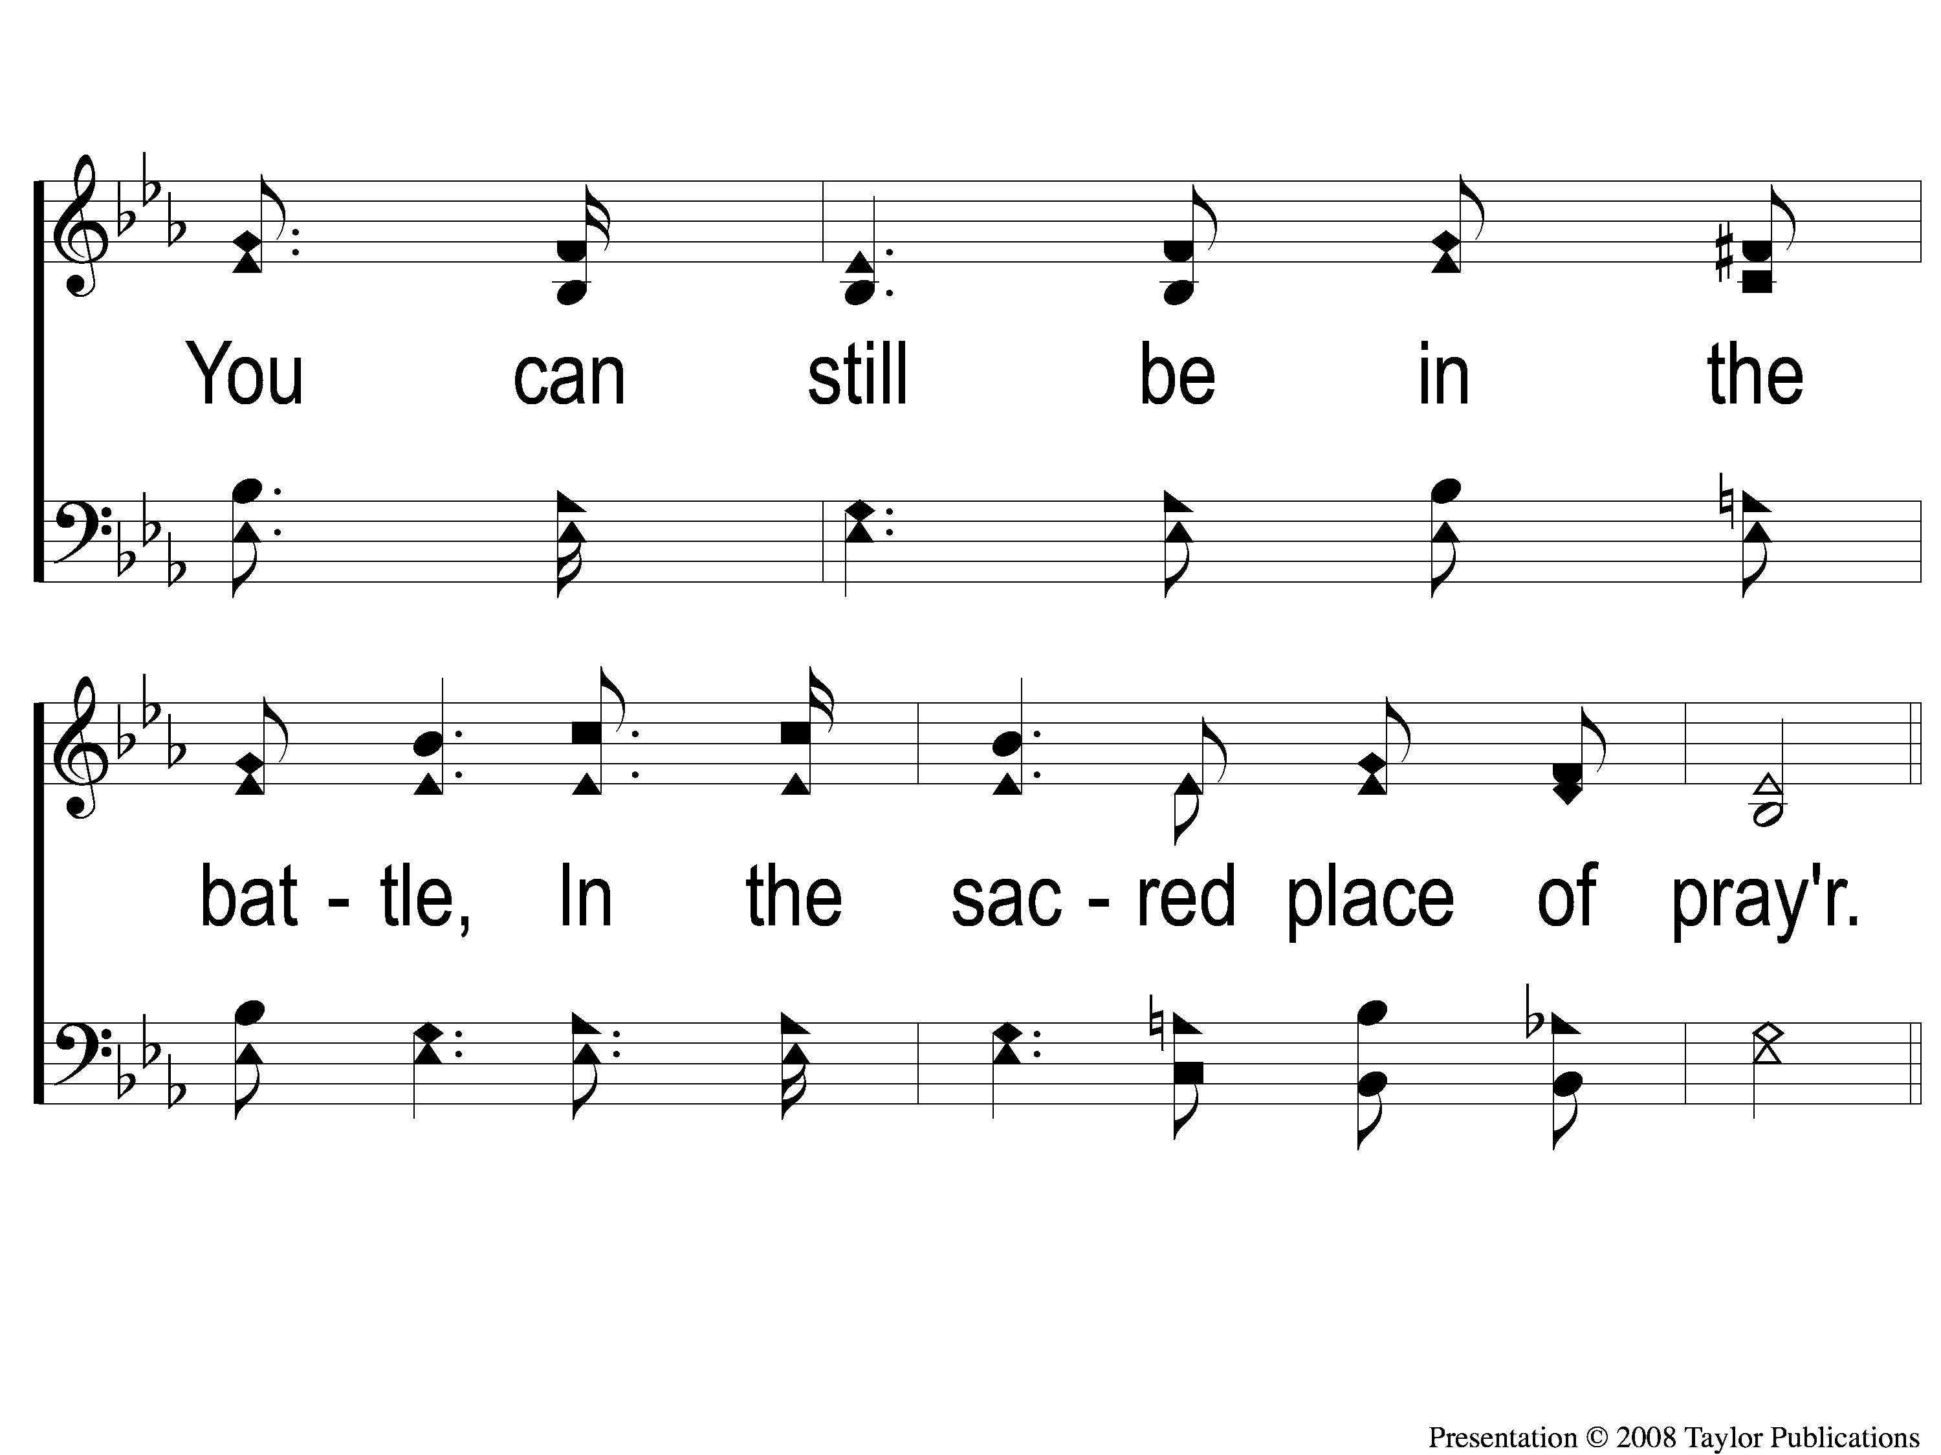
3-2 Little Is Much When God is In It
Little is Much When God is in It
86

Slide 11
C-1 Little Is Much When God is In It
Little is Much When God is in It
86

Slide 12
C-2 Little Is Much When God is In It
Little is Much When God is in It
86

Slide 13
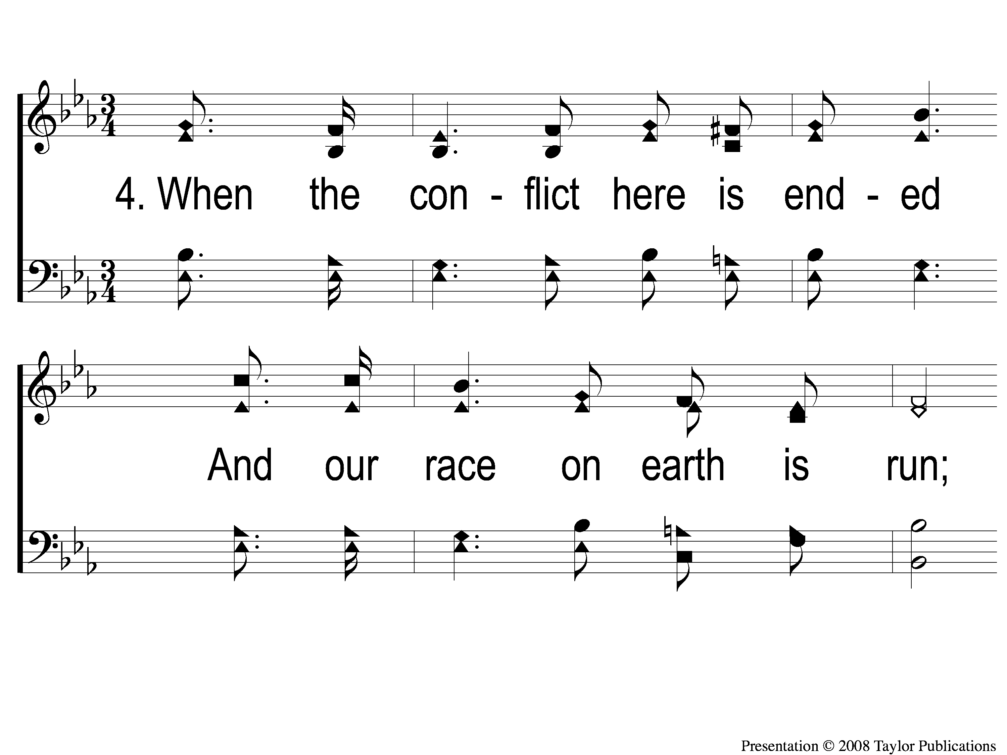
4-1 Little Is Much When God is In It
Little is Much When God is in It
86

Slide 14
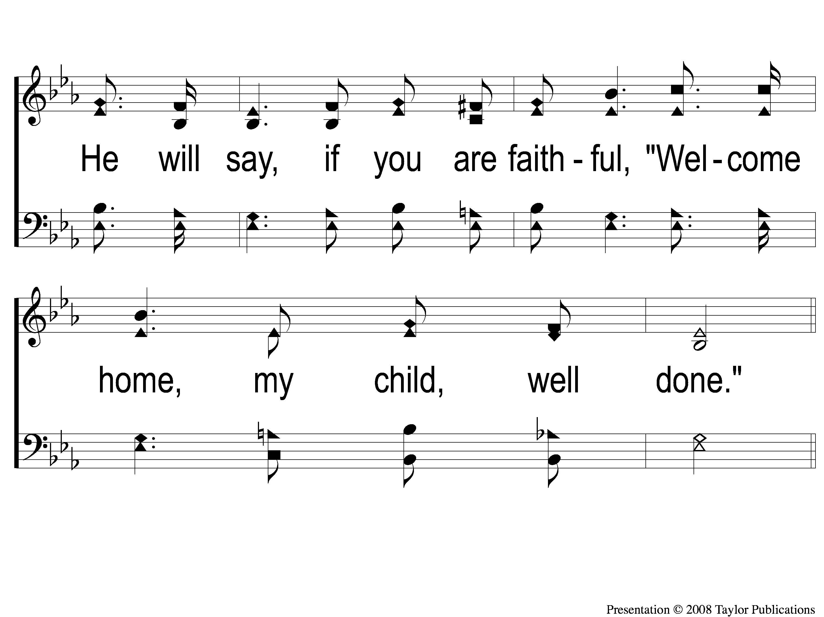
4-2 Little Is Much When God is In It
Little is Much When God is in It
86

Slide 15
C-1 Little Is Much When God is In It
Little is Much When God is in It
86

Slide 16
C-2 Little Is Much When God is In It
Little is Much When God is in It
86

